Slide 2


Slide 3
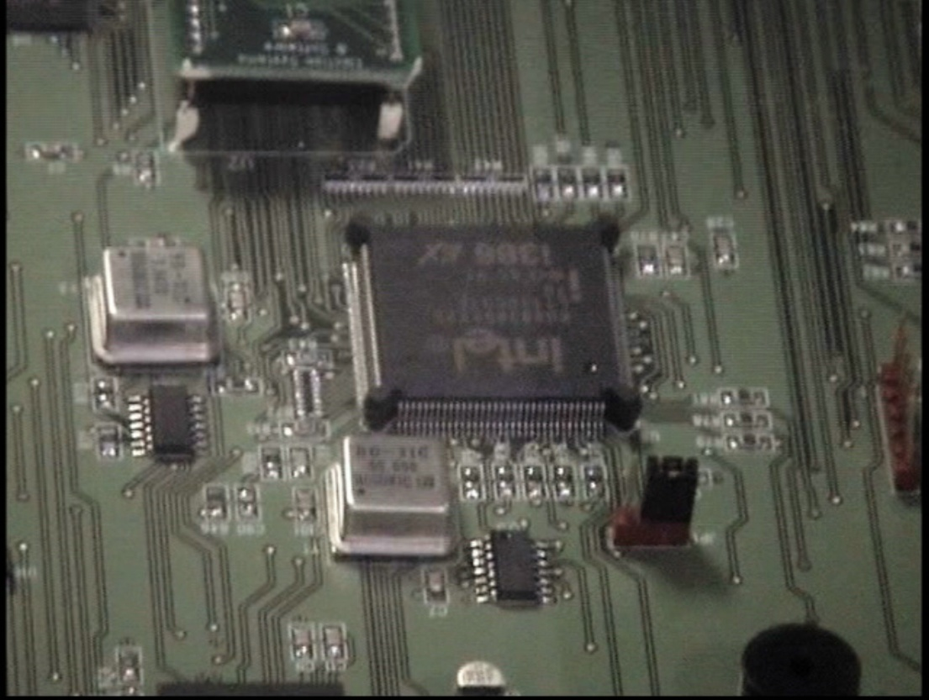
Machine Failure.. Intel 386SX Core processor on the iVotronic,chip fails below 5 Volts/ Some power sources tested at - 5 Volts.
Machines are not rated under 7V DC, for operations.
67 machines reported screen problems
17 machines report power problems
29 machines reported vote registration problems
26 Machines had failed and replaced screens, video boards, PEB communication port, from the primary 4 wks earlier. Replaced 10/19-17/06
14 Machines had bad power supplies, cords, from the primary just 4wks earlier.. Replaced 10/09-17/06
1 Machine had firmware error from primary, 10/09/06

Slide 4
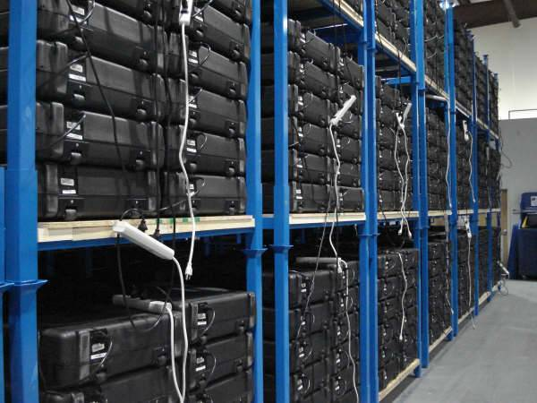
COOKING iVO- iVOTRONIC T SCREENS .. HANDLING PROBLEMS IN IT
SARASOTA FLORIDA WAREHOUSE PRIOR TO NOV 7TH ELECTION, SHOWS CHARGING BATTERIES INSIDE THE CASES AS A STANDARD PRACTICE. PHOTO taken by SOE Staff just prior to the NOV Election.
T Screen 12in iVotronic Brugquest ES&S Degrade in High temp and Humidity.

Slide 5
Seals between layers in screen fails and oxidation causes the thin conductivity coating on the layer to fail. The SOE warehouse staff adds to the problem with charging the batteries with the case closed.
HEAT * HUMIDITY destroy seals and allow oxidation of critical film that effects conductivity of the Screen

Slide 6
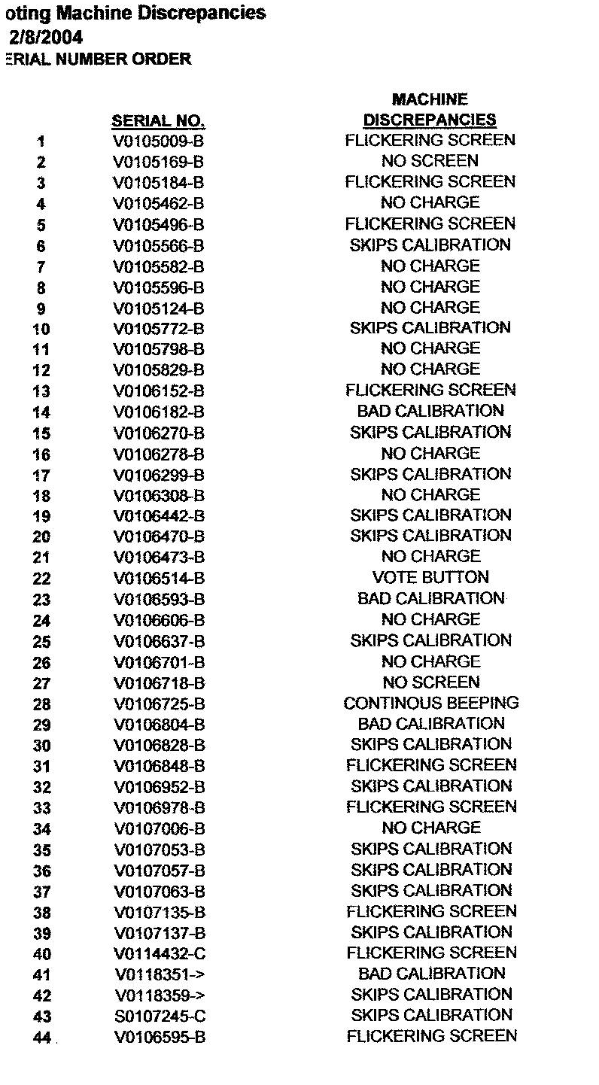
The 2001 Manufacture of Sarasota iVotrionic T Screens were ALL replaced by 1/27/04 – THEN just 11 months later after the 2004 Presidential Election they fail again. Setting a pattern of T Screen failure right through 2006. .
List from Sarasota warehouse records of the SOE.
Submitted to ES&S for warranty work replacement. 12/04

Slide 7
The SOE office never tells the media of problems or the voters. Further a FS 119 document request does not produce the 2004 paper work on the failed machines,
__________INETRNAL EMAIL FROM ELECIONS OFFICE
From: Walker, Bobby
Sent: Tuesday, January 27, 2004 3:46 PM
To: Elections
Subject: Maintenance
All our baby's have had their diapers changed. The iVotronic Maintenance is complete.
My thanks go out to Cindi Dietz from Pivot, her crew, the two ES & S guys and our staff out here. They did a great job as this was quite a task.
In your ventures with other counties and talks with ES & S I would very much appreciate it if you would pass along our praises for Cindi & the two ES & S guys for a job well done.
Cindi will be here for a little bit tomorrow finishing repairs on a couple of communication packs I believe there are 4 left to repair.
Thanks!
SOE Staff Person
& K Dent

Slide 8
Findings… Management.. Simple power tester back ordered.. In October…not used.
iVotronic™ Power Tester
 |  |  | Product #: 91638 The power tester allows poll workers to periodically check that the iVotronics™ are receiving power. To use the tester, unplug the connector from the iVotronic™ and plug it into the power tester. A green LED display light illuminates when the connector is receiving power from the outlet. Price: $3.00 each

Slide 9
Findings.. Management .. Power sources..
Day of Election multiple reports of power source failure in machines… See→ http://informedconsent.typepad.com
Dade County Study by Doug Jones Iowa State Univ 2004 on low power effect on storage of votes and difference in internal redundant memory locations inside the iVotronic. ( if memory #1 does not equal memory #2 ) .. Memory locations can not be relied on to be the same in extraction of votes from them …

Slide 10
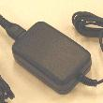
Findings …….Management /Failure of power sources
17 machines report power problems
8.7 DC/ AC inverter power source / ES&S
ES&S suggests no more than 5 linked machines together from a single power source, some Election Day machines reported 7-10 linked machines. Power inverters from AC to DC pictured were found in trash between the day of election and the recount, some traced to heavy undervote units, and tested below 5 V DC the fail threshold for the main board iVotronic processor chip the Intel 386SX.
29 machines reported vote registration problems

